Slide 2
Aim
To describe the movement of the Earth, and other planets, relative to the Sun in the solar system.
Success Criteria
I can name the planets in the correct order from the Sun.
I can explain how the Earth and other planets move around the Sun.
I can explain why planets orbit the Sun.

Slide 3
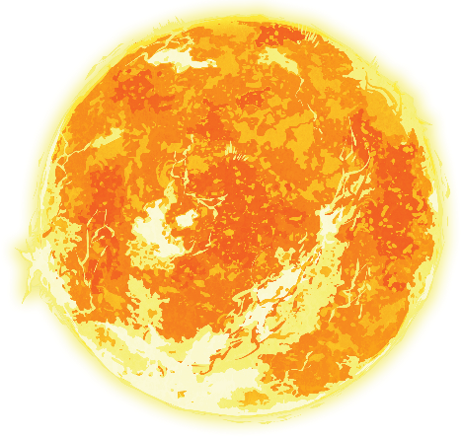
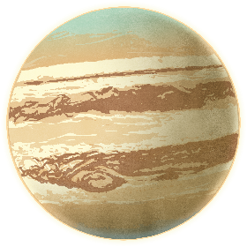
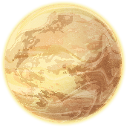
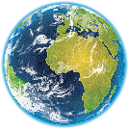
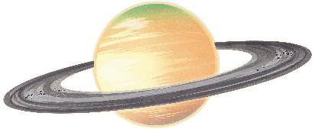

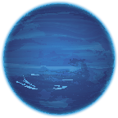
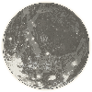
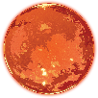
What Do You Already Know?
What do you already know about space?
Can you name any of the planets in our solar system?

Slide 4
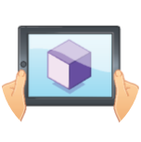
The Planets
There are eight planets in our solar system. Are you ready to take a closer look?
You are here
Make sure you are connected to the correct tour and that your device is pointing at a marker sheet.

Slide 5
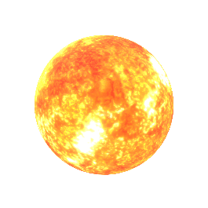
The Planets
There are eight planets in our solar system. Are you ready to take a closer look?
The Sun
The Sun is a star in the middle of our solar system. It is incredibly hot – temperatures on the surface of the Sun can reach 5500°C!
The Sun is a planet. True or false?
False – the Sun is a star.
People used to believe that the Sun and the other planets moved around the Earth. However, we now know that the Sun is in the centre of the solar system and that the Earth and all the other planets move around it.

Slide 6
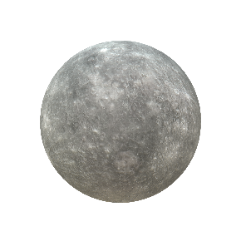
The Planets
Distance from the Sun:
58 million kilometres
One day lasts: 59 Earth days
One year lasts: 88 Earth days
Mercury
Only two spacecraft have ever visited Mercury.
True or false?
True – it is difficult to reach the planet
due to how close it is to the Sun.
Mercury is the closest planet to the Sun, and the smallest planet in our solar system. It does not have any moons or rings. Its rocky surface is covered with craters caused by meteors hitting the planet.

Slide 7
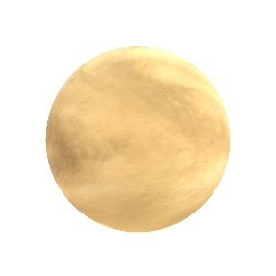
The Planets
Distance from the Sun:
108 million kilometres
One day lasts: 243 Earth days
One year lasts: 225 Earth days
Venus
Venus is the second planet from the Sun. It is often called Earth’s sister planet, as they are similar in size and made of similar materials. However, the surface of Venus is not where you’d want to be. The atmosphere is so thick that it would crush you – and the planet is completely covered by clouds of sulphuric acid that smell like rotten eggs!
True – it has an average surface temperature
of 462°C. That’s hot enough to melt lead!
Venus is the hottest planet in the solar system. True or false?

Slide 8
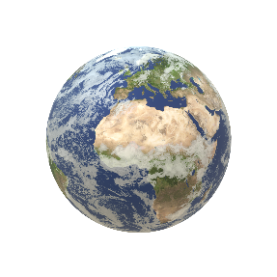
The Planets
Distance from the Sun:
150 million kilometres
One day lasts: 24 hours
One year lasts: 365 days
Did you know that Earth is nicknamed the Blue Planet? From space, we can see that it appears blue because around 71% of the Earth’s surface is covered by water. Earth was formed around 4.54 billion years ago and is currently the only known planet to support life.
Earth is the third planet from the Sun.
True or false?
True.
Earth

Slide 9
The Moon
Distance from the Sun:
150 million kilometres
One day lasts: 27.3 days
One year lasts: 365 days
Some planets in our solar system have dozens of moons, and some planets have no moons at all. Earth has one moon. In 1969, Neil Armstrong was the first person to ever walk on the Moon. As he took his first step onto the surface of the Moon, he said the now-famous words: ‘That's one small step for man, one giant leap for mankind.
Only one side of the Moon is visible from Earth.
True or false?
True.

Slide 10
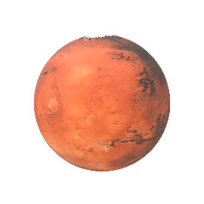
Distance from the Sun:
228 million kilometres
One day lasts: 24 hours and 37 minutes
One year lasts: 687 days
The Planets
Mars is the fourth planet from the Sun. It is sometimes called the Red Planet because of the brownish-red colour of its rocky surface. Space agencies have sent many rover missions to Mars to explore the surface and find out if Mars might have had life in the past. To date, no proof of any past or present life on Mars has been found.
True – they are named Phobos and Deimos.
Mars has two moons. True or false?
Mars

Slide 11
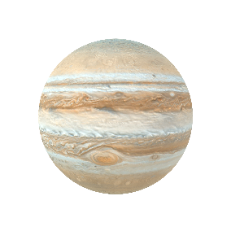
The Planets
Distance from the Sun:
778 million kilometres
One day lasts: 10 hours
One year lasts: 11.9 Earth years
Jupiter is the fifth planet from the Sun, and the largest planet in our solar system. Jupiter is a gas giant – a giant planet mainly made up of gases such as hydrogen and helium. As it has no solid surface, trying to land on Jupiter would be like trying to land on a cloud. Jupiter has 79 known moons!
Jupiter’s gravity is weaker than the gravity on Earth. True or false?
False – because Jupiter is so huge, its gravity is much stronger than the gravity on any other planet in the solar system.
Jupiter

Slide 12
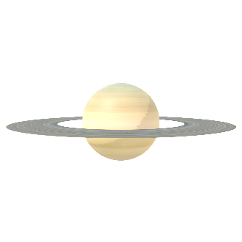
The Planets
Distance from the Sun:
1.4 billion kilometres
One day lasts: 10.7 hours
One year lasts: 29 Earth years
Saturn is the sixth planet from the Sun. It is another gas giant. The rings of Saturn, which are made up of countless small chunks of rock and ice, make Saturn one of the most recognisable planets in the solar system. Saturn currently has 82 known moon. 53 of these moons are named.
False – Jupiter has the shortest day.
A day on Jupiter is only ten hours long!
Saturn has the shortest day out of all the planets. True or false?
Saturn

Slide 13
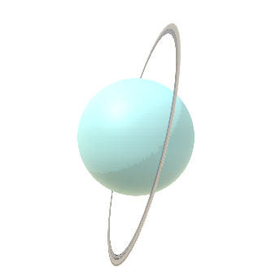
The Planets
Distance from the Sun:
2.9 billion kilometres
One day lasts: 17 hours
One year lasts: 84 Earth years
Uranus
Uranus is the seventh planet from the Sun. It is an ice giant – a type of gas giant planet with an icy core. Uranus is tilted so strongly to one side that its rings are tilted, too. It is still a mystery why Uranus has such a large tilt. Many astronomers think that Uranus may have been hit by something really big a long time ago, which knocked it over onto its side.
Uranus is named after one of the Greek
gods of the sky. True or false?
True.

Slide 14
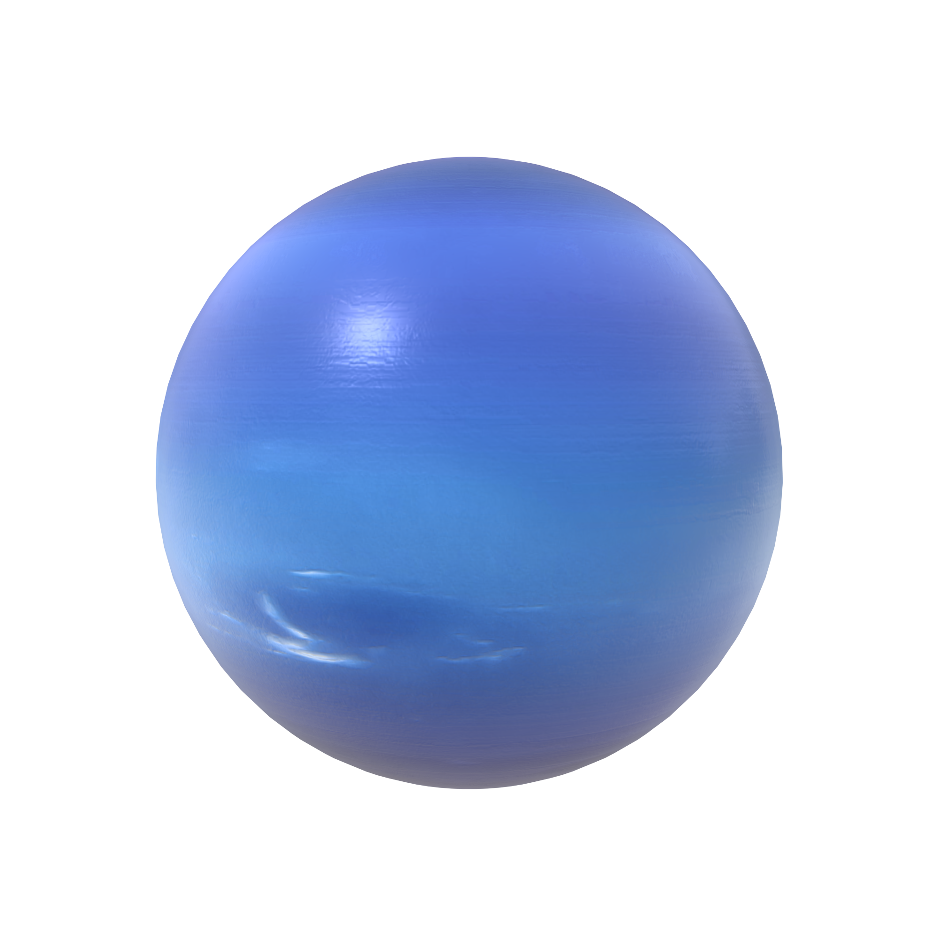
The Planets
Distance from the Sun:
4.5 billion kilometres
One day lasts: 16 hours
One year lasts: 165 Earth years
Neptune is the eighth planet from the Sun, and another ice giant. It’s so far away that it is the only planet not visible from Earth without a telescope. It is an extremely cold planet with the fastest winds in the solar system. Wind speeds on Neptune have been recorded to reach as high as 1,300 miles per hour – nearly the speed of a fighter jet!
True – they are all named after minor water gods from Greek mythology.
Neptune has 14 moons. True or false?
Neptune

Slide 15
The Planets
The Sun and these eight planets make up our solar system. There are many other objects in the solar system too, such as moons, comets, asteroids and dwarf planets. Our solar system is one of many. Scientists think that there may be tens of billions of other solar systems out there – and that’s just in our galaxy!
Mercury
Earth
Jupiter
Uranus
Venus
Mars
Saturn
Neptune
Sun

Slide 16
The Solar System
Now it’s your turn!
1. The Solar System
With your teacher, use AR to explore the solar system and learn how planets move around the Sun.
2. How Do Planets Move around the Sun?
Complete the worksheet to show what you have learned about planets and how they orbit the Sun. You could use AR independently to take another look.
3. Research a Planet
Find out more about one of the planets you have learned about today.
4. Solar System Quiz
Write a quiz with five questions about the solar system and test the other members of your group.
5. Planets Mnemonic
Create your own mnemonic to remember the order of the planets from the Sun.
Your teacher will split you into four groups for a carousel of activities. Are you ready to show what you know?

Slide 17
The Sun is a star that spins anticlockwise in the middle of our solar system, surrounded by eight planets.
1. The Sun
2. Orbits
3. Gravity
4. Day and Night
The Solar System
5. Clockwise or Anticlockwise?
The Sun is a star that spins anticlockwise in the middle of our solar system, surrounded by eight planets.
The Sun is a star that spins anticlockwise in the middle of our solar system. It is surrounded by eight planets.
Make sure you are connected to the correct tour and that your device is pointing at a marker sheet.

Slide 18
The Sun is a star that spins anticlockwise in the middle of our solar system, surrounded by eight planets.
1. The Sun
2. Orbits
3. Gravity
4. Day and Night
The Solar System
5. Clockwise or Anticlockwise?
The Sun is a star that spins anticlockwise in the middle of our solar system, surrounded by eight planets.
Every planet in the solar system moves anticlockwise around the Sun, following a curved path. We call this curved path an orbit. Although it looks like some of them are orbiting in a circle, each planet’s orbit around the Sun is shaped like an ellipse.
When a planet makes one complete orbit around the Sun, this is counted as one year on that planet. The time that it takes each planet to orbit once around the Sun depends on how fast the planet is travelling and how far away it is from the Sun. This means that a year lasts for different lengths of time on different planets. Can you see which planets have the longest years?
Make sure you are connected to the correct tour and that your device is pointing at a marker sheet.

Slide 19
The Sun is a star that spins anticlockwise in the middle of our solar system, surrounded by eight planets.
1. The Sun
2. Orbits
3. Gravity
4. Day and Night
The Solar System
5. Clockwise or Anticlockwise?
The Sun is a star that spins anticlockwise in the middle of our solar system, surrounded by eight planets.
The planets orbit the Sun because they are caught by the Sun’s massive gravitational force. Without the pull of the Sun’s gravity, the planets would no longer follow their paths around the Sun and would go flying off in a straight line into space.
In the same way that each planet orbits the Sun, most planets are also orbited by smaller objects that are caught by the planet’s gravity. For example, Earth is orbited by the moon. Some planets are orbited by lots of moons. Can you remember which planets have a large number of moons?
Make sure you are connected to the correct tour and that your device is pointing at a marker sheet.

Slide 20
The Sun is a star that spins anticlockwise in the middle of our solar system, surrounded by eight planets.
1. The Sun
2. Orbits
3. Gravity
4. Day and Night
The Solar System
5. Clockwise or Anticlockwise?
The Sun is a star that spins anticlockwise in the middle of our solar system, surrounded by eight planets.
Each planet also spins on its axis as it moves. At any one time, it is daytime for the part of the planet that is facing the Sun and night-time for the part that is facing away. As some planets spin faster than others, the length of a day can vary greatly between different planets. Can you remember which planets have the shortest days?
Make sure you are connected to the correct tour and that your device is pointing at a marker sheet.

Slide 21
The Sun is a star that spins anticlockwise in the middle of our solar system, surrounded by eight planets.
1. The Sun
2. Orbits
3. Gravity
4. Day and Night
The Solar System
5. Clockwise or Anticlockwise?
The Sun is a star that spins anticlockwise in the middle of our solar system, surrounded by eight planets.
Can you see which planet is spinning in a different direction from the others?
Although most planets spin anticlockwise, the same way as the Sun, Venus rotates in a clockwise direction. We think that this is because Venus was struck by a large object long ago, which changed the way in which it was spinning. Uranus also spins in an unusual way – it is tilted so far over to one side that it almost looks as if it is rolling along.
Click to reveal the answer
Make sure you are connected to the correct tour and that your device is pointing at a marker sheet.

Slide 22
Show What You Know

Slide 23
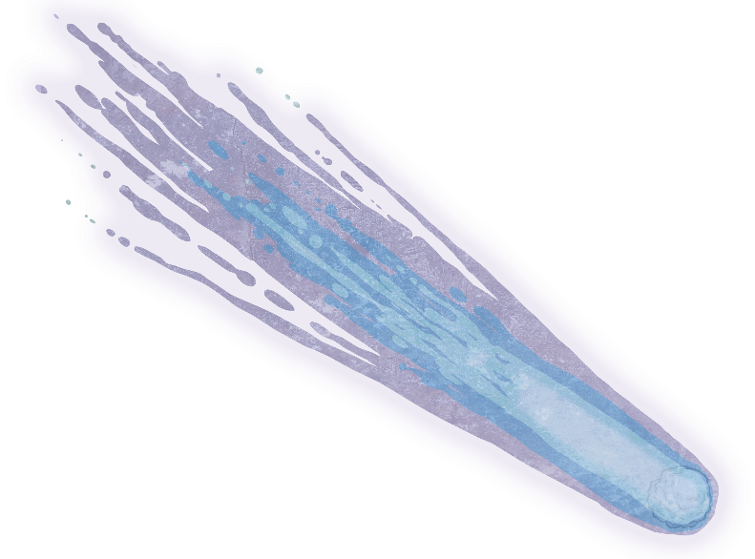
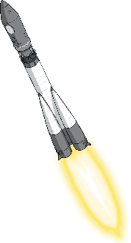
1
What type of object is the Sun?
a comet
a planet
a star
Next
Question

Slide 24
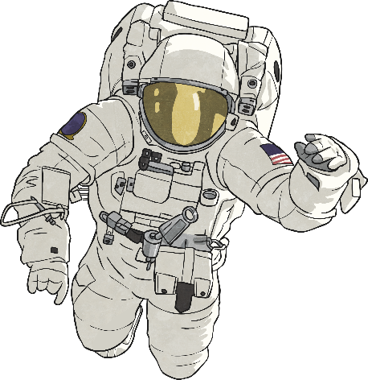
2
What is an orbit?
a type of sweet
a curved path in space that one object takes around another
a star
Next
Question

Slide 25

3
What keeps the planets in orbit around the Sun?
speed
gravity
magic
Next
Question

Slide 26
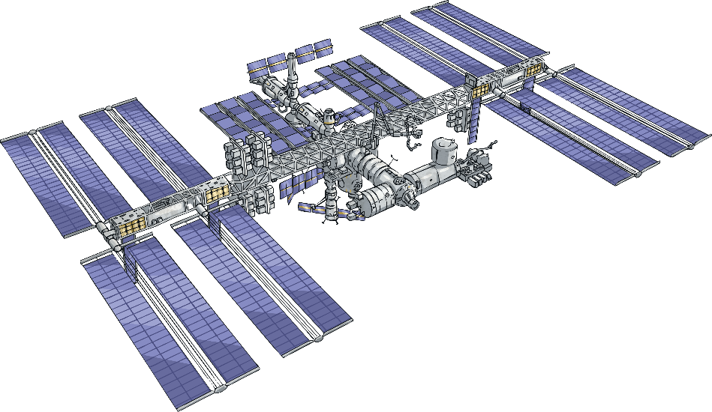
4
Which planet is the fifth from the Sun?
Earth
Saturn
Jupiter
Next
Question

Slide 27
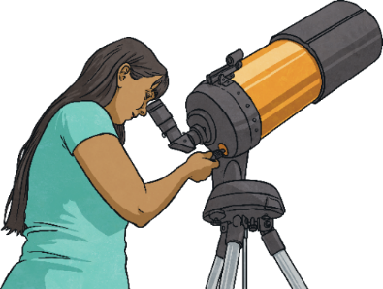
5
Which word describes the rough shape of a planet?
spherical
circular
ovoid
Next
Question

Slide 28
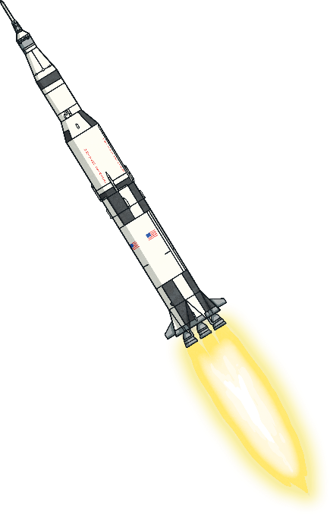
6
Which word do we use to describe the Sun being at the centre of our solar system?
geocentric
heliocentric
areocentric
Next
Question

Slide 29
7
Why has Pluto not been classed as
a planet since 2006?
it floated out of the solar system
it exploded
we changed the way in which we classify planets
Next
Question

Slide 30
8
Which planets are classed as
gas giants?
Jupiter and Saturn
Mercury and Venus
Earth and Mars
Next
Question

Slide 31
9
How many moons does Mars have?
one
two
five
Next
Question

Slide 32
10
One year is the time that it takes for a planet to…
make one complete orbit around the Sun
complete one rotation on its axis
have 365 days pass by
Next
Question

Slide 33
11
In which direction do the planets in our solar system orbit the Sun?
different planets orbit in different directions
clockwise
anticlockwise
Next
Question

Slide 34
12
What causes day and night on a planet?
as a planet rotates on its axis, different parts of the planet face the Sun
the planet moving too far away from the Sun
other planets blocking the light from the Sun
Next
Question

Slide 35
13
Which is the largest planet in our
solar system?
Neptune
Jupiter
Saturn
Next
Question

Slide 36
14
Which is the smallest planet in our
solar system?
Mercury
Venus
Mars
Next
Question

Slide 37
15
Which mnemonic orders the
planets correctly?
Energetic Jumping Monkeys Mainly Utter Very Silly Noises
Most Visitors Eat Mouldy Jam Sandwiches Until November
My Very Exciting Magical Nana Juggles Ugly Skateboards
Next
Question

Slide 38
Aim
To describe the movement of the Earth, and other planets, relative to the Sun in the solar system.
Success Criteria
I can name the planets in the correct order from the Sun.
I can explain how the Earth and other planets move around the Sun.
I can explain why planets orbit the Sun.

